Slide 1
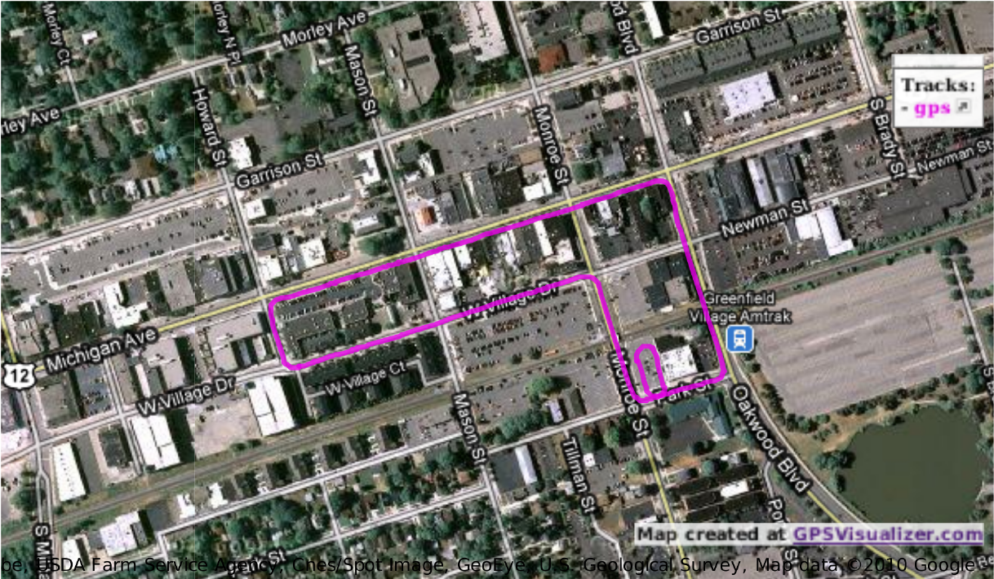
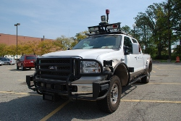
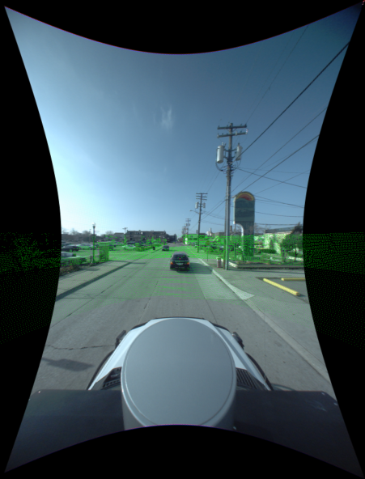
LIDAR / Video / Optical Flow
M.Giering, V.Venugopalan, K.Reddy
Ford Campus Vision and Lidar Dataset
Ford's F-250 serves as an experimental platform for this data collection
The vehicle is outfitted with
Inertial Measuring Unit (IMU)
Velodyne 3D-lidar scanner
Two push-broom forward looking Riegl lidars
Point Grey Ladybug3 omnidirectional camera system
Source: http://robots.engin.umich.edu/SoftwareData/Ford
UTC PROPRIETARY - Export Controlled - ECCN: EAR99

Slide 2
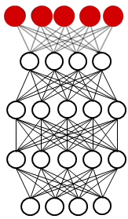

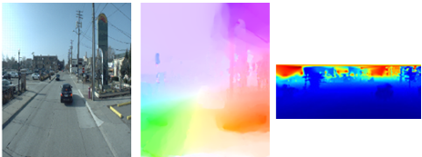
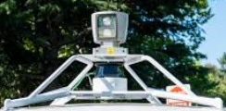

LIDAR / Video / Optical Flow
aaa
What is Big Data?
M.Giering, V.Venugopalan, K.Reddy
Auto-registration via CNN
Neurons / Layer
Offset the Video data set by [0,8,16,24,32] pixels relative to LIDAR.
Divide each channel into 32x32 patches with stride of 8 pixels.
Train a 3-layer CNN to classify the degree of offset for each.
LIDAR / video
sensor alignment
correction
1
2
3
4
5
5
81
325
Deep neural network
1500
Training: 1st half of driving loop Testing: 2nd half of driving loop
For each image frame get the distribution of “votes” for each offset.
Future improvement: Incorporation of more temporal information
6000
800 pixels
800 x 250 pixels
Input data
Video
Optical flow
LIDAR
D,U,V,R,G,B
Channels
PATCH
IMAGE
LIDAR / Video Sensor Suite
UTC PROPRIETARY - Export Controlled - ECCN: EAR99

Slide 3
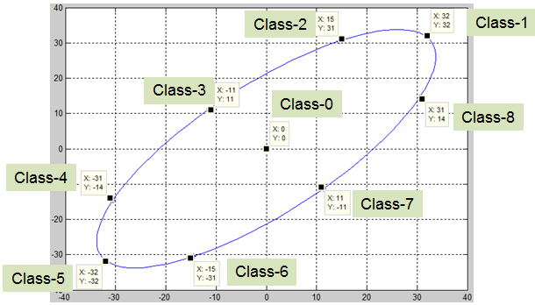

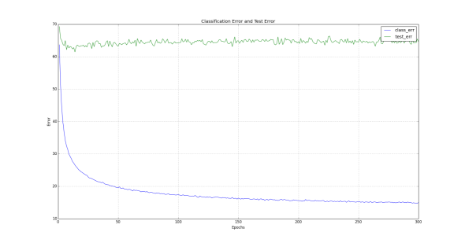
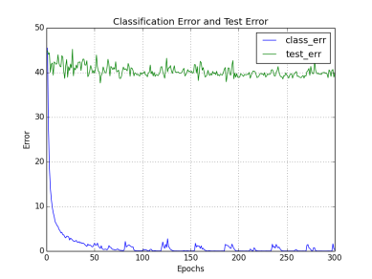
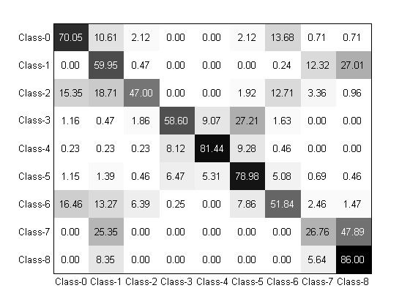
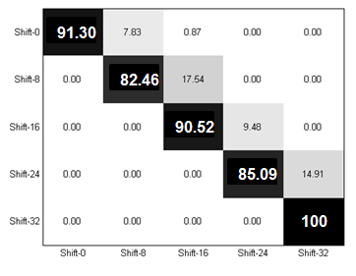
LIDAR / Video / Optical Flow - CNN
M.Giering, V.Venugopalan, K.Reddy
Auto-registration
Repeat experiment, but vary both magnitude and direction of offsets.
15% patch level
training error
Image-level confusion matrix
for offsets
Image-level confusion matrix
for offsets
UTC PROPRIETARY - Export Controlled - ECCN: EAR99

Slide 4
LIDAR / Video / Optical Flow
M.Giering, V.Venugopalan, K.Reddy
Auto-registration via CNN
Whether spatial or temporal, sensor registration is a significant challenge in most multi-modal analytic tasks.
Subsequent analysis of the fused data models are dependent on the accuracy and persistence of registration.
6 Channels = [R,G,B,U,V,D]
Each image is 800 x 250 pixels
Each patch is 32x32 pixels
Filter: Any LIDAR patch with variance < t, triggers the elimination of that patch for all 6 channels.
No tuning.
No use of temporal information beyond optical flow.
Offset the Video data set by [0,8,16,24,32] pixels relative to LIDAR.
Divide each channel into 32x32 patches with stride of 8 pixels.
Train a 3-layer CNN to classify the degree of offset for each.
800 pixels
800 x 250 pixels
D,U,V,R,G,B
Channels
PATCH
IMAGE
UTC PROPRIETARY - Export Controlled - ECCN: EAR99

Slide 5
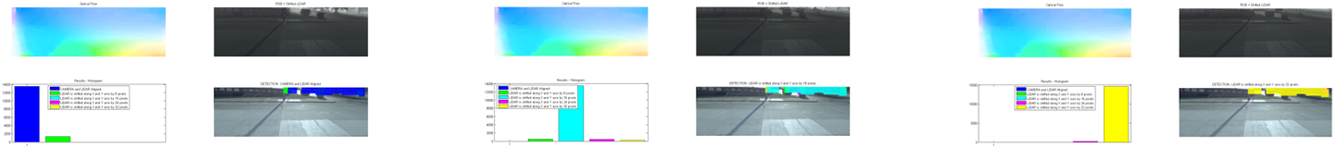
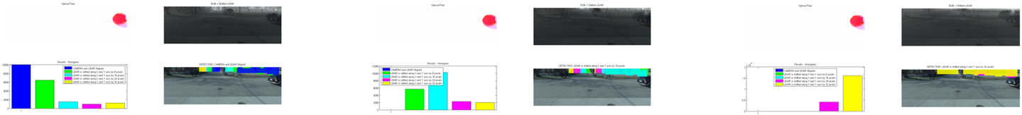
LIDAR / Video / Optical Flow - CNN
M.Giering, V.Venugopalan, K.Reddy
Anecdotal evidence that optical flow improves discrimination
Value
While stopped at red lights (low optical flow), offset ambiguity increases.
UTC PROPRIETARY - Export Controlled - ECCN: EAR99

